Slide 1



DBMS LAB with Mini Project
Experiment – 3
MOVIE Database
Department of Computer Science and Engineering
SGBIT
1

Slide 2

Create Movie Database
Aim of the Experiment
Demonstrate working of SQL queries
Department of Computer Science and Engineering
SGBIT
2

Slide 3
Movie Database
ACTOR
Actor_id | Actor_Name | Actor_Gender
DIRECTOR
Director_id | Director_Name
MOVIES
Movie_id | Movie_Title | Year | Language | Dir_id
MOVIE_CAST
MOVIE_RATING
Department of Computer Science and Engineering
SGBIT
Movie_id | Actor_id | Role
Movie_id | Rev_stars
3

Slide 4
Queries – DQL statements
1. List the titles of all movies directed by ‘Hitchcock’
Select title from Movies M, Director D
Where M.Dir_id=D.Dir_id and Dir_name=‘Hitchcock’;
Department of Computer Science and Engineering
SGBIT
4

Slide 5
Queries
2. List all actors who acted in a movie before
2000 and in a movie after 2015 (use JOIN operation).
Select Actor_name from ACTOR A
INNER JOIN MOVIE_CAST MC ON A.Actor_id=MC.Actor_id
WHERE Movie_Year<2000 and
Movie_Year>2015
Department of Computer Science and Engineering
SGBIT
5

Slide 6
Queries
2. Delete a book in Book table
DELETE from BOOK Where Book_id=&bookID;
Department of Computer Science and Engineering
SGBIT
6

Slide 7
SQL Queries
Find the title of movies and number of stars for each movie that has at least one rating and find the highest number of stars that movie received. Sort the result by movie title
SELECT MOV_TITLE, MAX (REV_STARS)
FROM MOVIES INNER JOIN RATING USING (MOV_ID) GROUP BY MOV_TITLE
HAVING MAX (REV_STARS)>0
ORDER BY MOV_TITLE
Department of Computer Science and Engineering
SGBIT
7

Slide 8
DDL with Partition concept
Q Update rating of all movies directed by ‘Steven Spielberg’ to 5
UPDATE RATING SET REV_STARS=5
WHERE MOV_ID IN (SELECT MOV_ID FROM MOVIES
WHERE DIR_ID IN
(SELECT DIR_ID FROM DIRECTOR
WHERE DIR_NAME = ‘STEVEN SPIELBERG’))
Department of Computer Science and Engineering
SGBIT
8

Slide 9
DQL – Statement on partition
SELECT p2017, TABLE_ROWS FROM
INFORMATION_SCHEMA.PARTITIONS
WHERE TABLE_NAME = ‘BOOKS';
Department of Computer Science and Engineering
SGBIT
9

Slide 10
DML - Statement
CREATE VIEW of all Books and its number of copies that are currently available in Library
CREATE VIEW BOOK_COPIES AS
SELECT B.Book_id, Title, No_of_copies
FROM BOOK B, BOOK_COPIES BC
where B.Book_id=BC.Book_id);
Department of Computer Science and Engineering
SGBIT
10

Slide 11
Login with your credentials
Let us Proceed…..
SQL> connect username as sysdba;
Password :
Connected..
SQL>
Department of Computer Science and Engineering
SGBIT
11

Slide 12
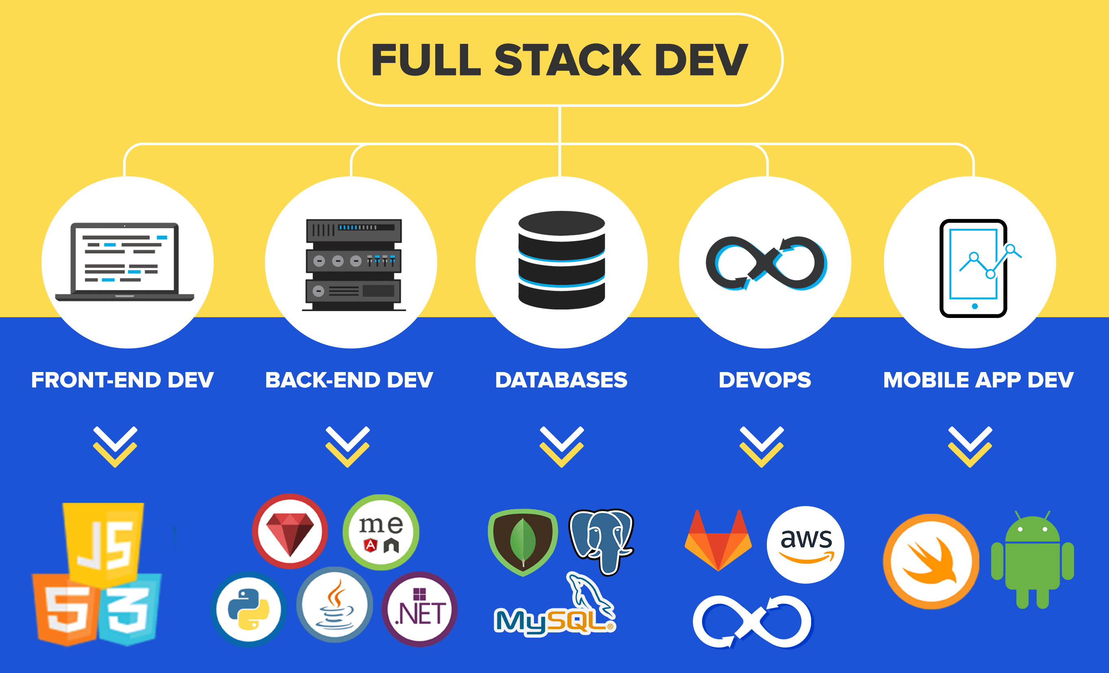
Full Stack Development
Department of Computer Science and Engineering
12

Slide 13
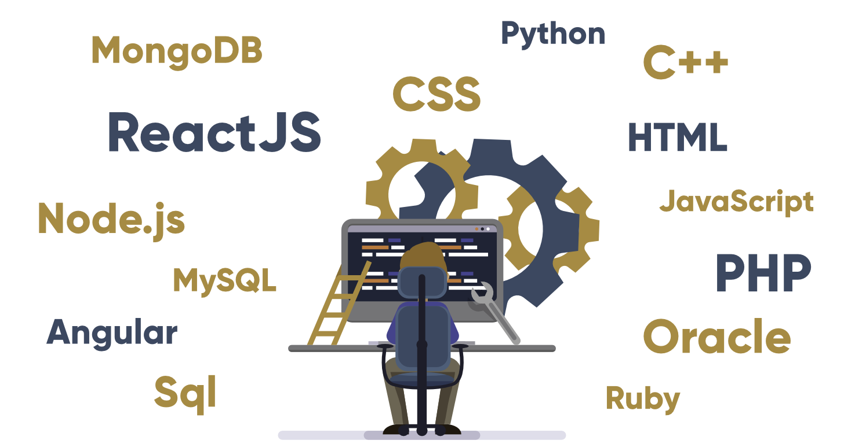
Full Stack Developer
Full stack is a collection of tools, technologies, and programming languages required to develop and deploy projects
Department of Computer Science and Engineering
13

Slide 14
Popular Stacks : MEAN and MERN
MEAN stack includes the following: Front-end framework: JavaScript and AngularJS Database: MongoDB Web-framework: Node.js Back-end web framework: Express.js | MERN stack, like MEAN stack, consists of JavaScript-based technologies. These are the main components of MERN stack: Database: MongoDB Web Programming Framework: Express Building UI: Node.js and React
Department of Computer Science and Engineering
14

Slide 15
Full Stack Developer : Salaries
USA = 1,12000 $ Australia & Canada – 1,10000$ Germany – 54,000 Euros India – 8-10 lakh per anum
Department of Computer Science and Engineering
15

Slide 16
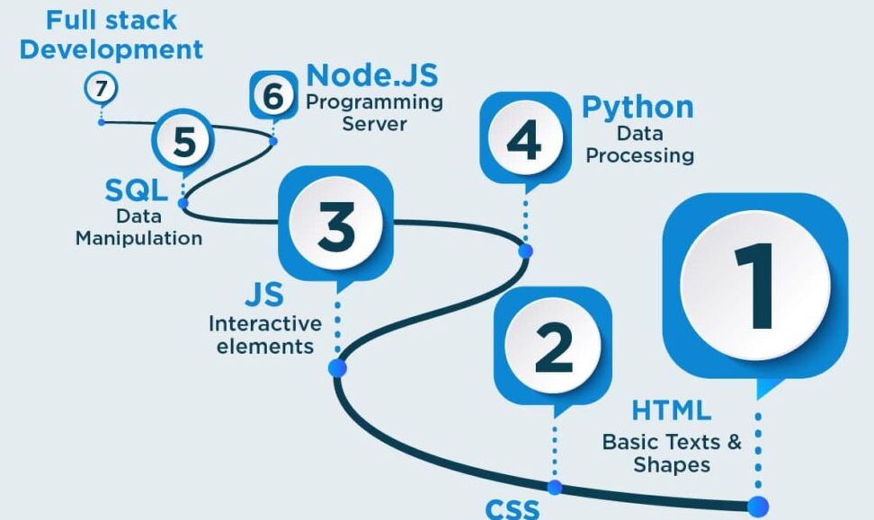
Full Stack Development - Roadmap
Department of Computer Science and Engineering
16

Slide 17
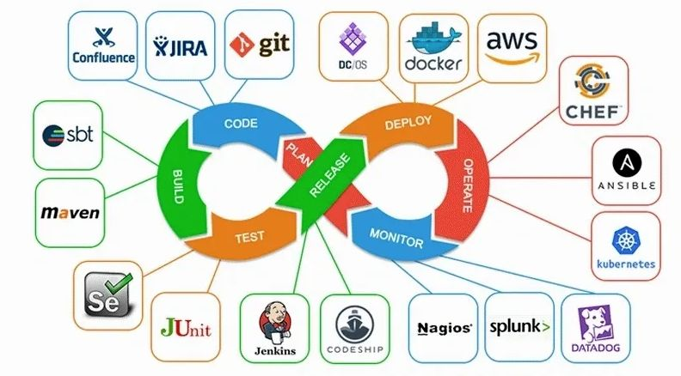
Development Process – Agile Approach
Department of Computer Science and Engineering
17

Slide 18
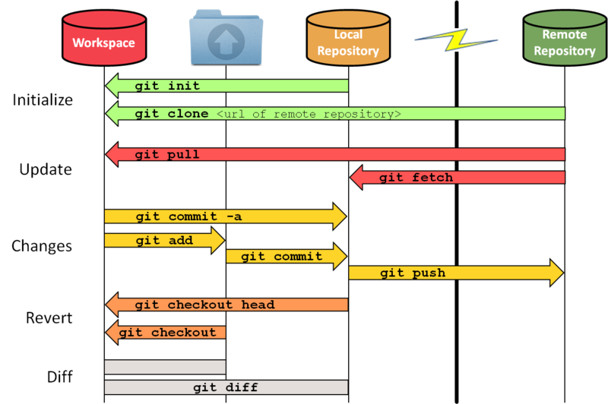
Version Control Tool – git and github
Department of Computer Science and Engineering
18

Slide 19
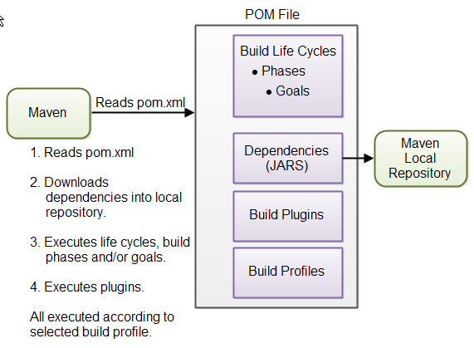
Build Tool – Maven
Department of Computer Science and Engineering
19

Slide 20
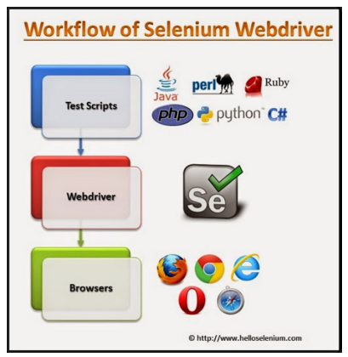
Testing Tool – Selenium
Department of Computer Science and Engineering
20

Slide 21
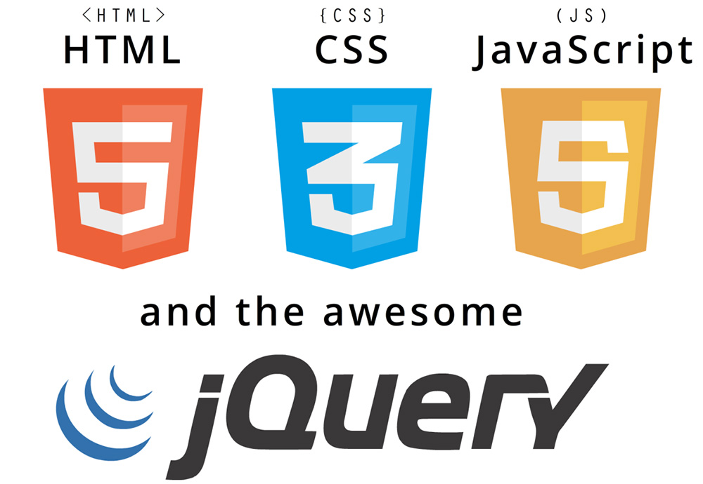


Technologies and Frameworks
Department of Computer Science and Engineering
21

Slide 22
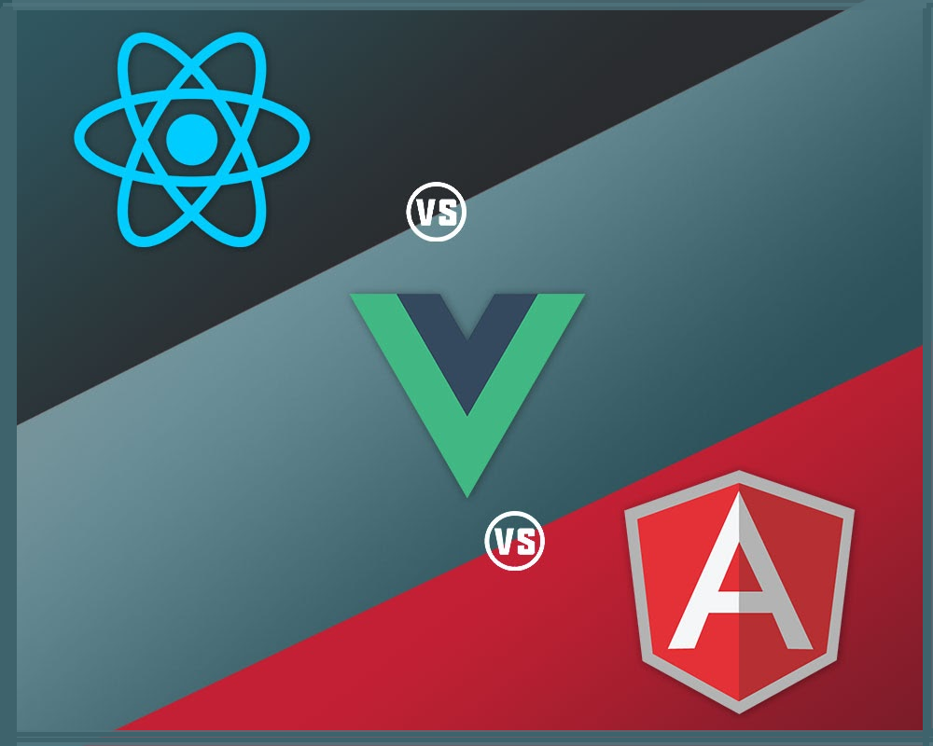
Technologies and Frameworks
Department of Computer Science and Engineering
22

Slide 23

Other backend frameworks
Department of Computer Science and Engineering
23

Slide 24
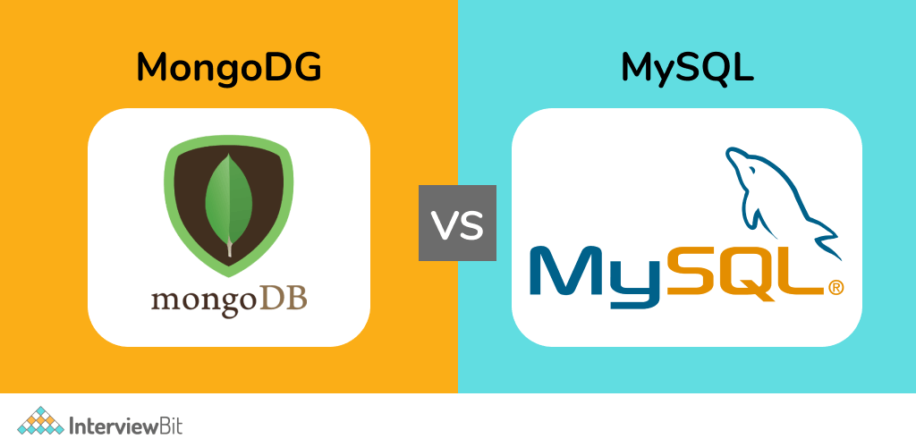
SQL and NoSQL database systems
Department of Computer Science and Engineering
24

Slide 25
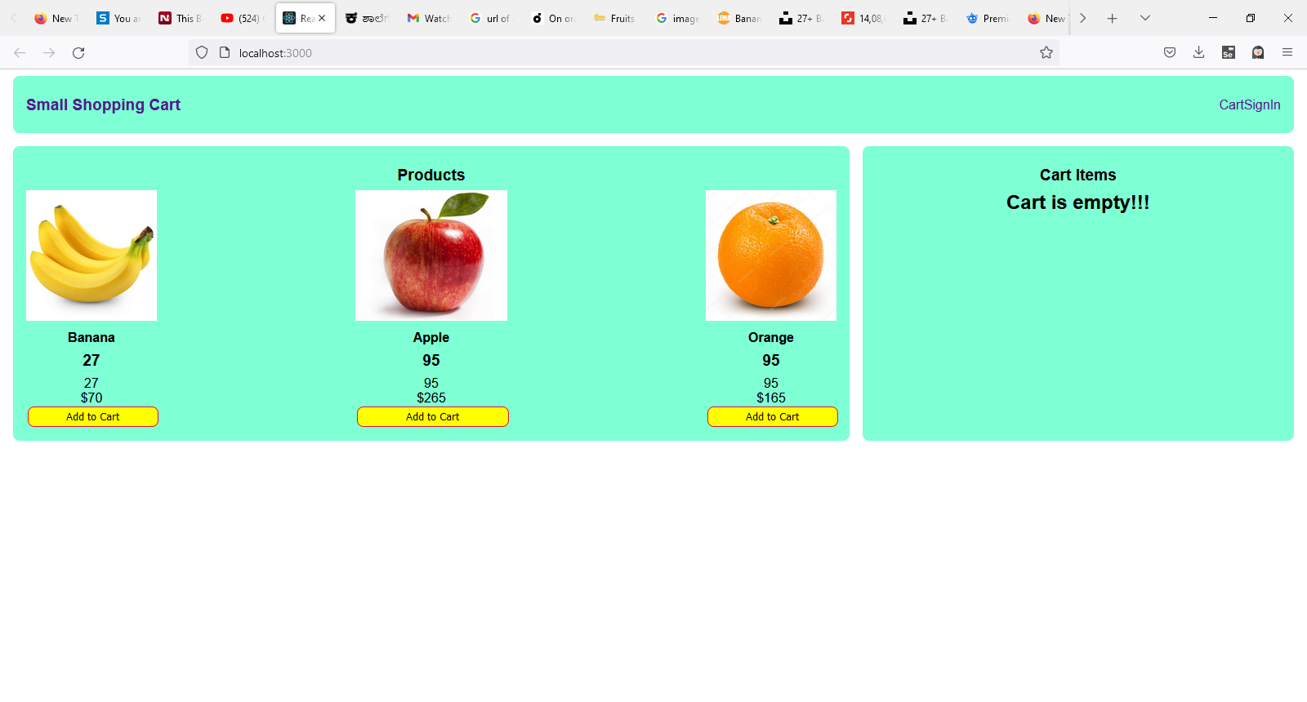
Internship Outcome
Department of Computer Science and Engineering
25

Slide 26
Software's needed
1. Visaul Studio Code - vscode
2. Nodejs
3. Xamp
4. Git for windows
5. Dia – Opensource UML Tool
Department of Computer Science and Engineering
26

Slide 27
Beyond class activity
Interesting Assignments
Sharing of useful videos
3. Preparing internship reports
4. Documenting and testing the code
Department of Computer Science and Engineering
27

Slide 28
Important resources and platforms
w3School.com
tutorialspoint.com
uootstrap.com
Udemy.com
coursera.com
stackoverflow.com
mvnrepository.com
Department of Computer Science and Engineering
28

Slide 29
So… Lets go and Get started..
Are you Ready ?
Department of Computer Science and Engineering
29

Slide 30

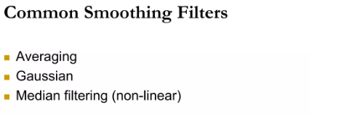
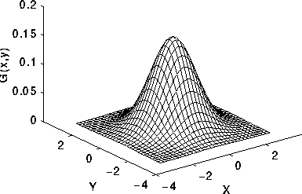
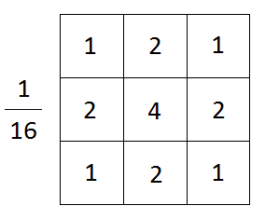
Image Processing – Common Smoothing Filters
Smoothing Filter
Gaussian filter
Department of Computer Science and Engineering
30

Slide 31
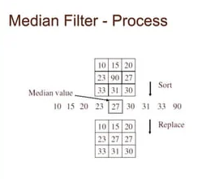
Image Processing – Common Smoothing Filters
Smoothing Filter
Median filter
Department of Computer Science and Engineering
31
31

Slide 32
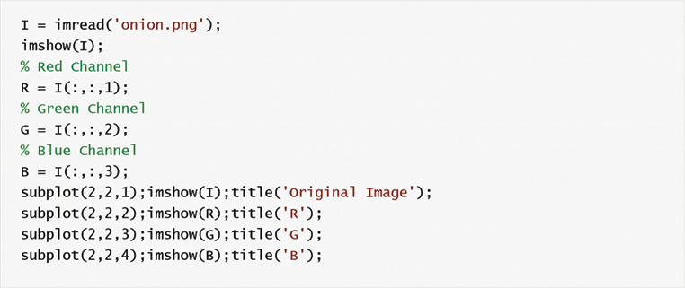
Image Processing – MatLab code
Department of Computer Science and Engineering
32

Slide 33
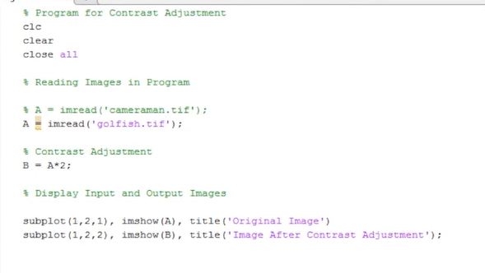
Image Processing – MatLab code
Department of Computer Science and Engineering
33

Slide 34
Image Processing – Important Points
Images are stored as pixel intensities as Grayscale or Color Images
Color Images can be converted to Grayscale
Image Enhancement can be done in
Spatial, Frequency or Homomorphic domains
Department of Computer Science and Engineering
34

Slide 35
Image Processing – Important Points
Thank You..
Department of Computer Science and Engineering
35

